Slide 1
Review: Simultaneous Internal Diffusion & External Diffusion
Goal: Derive a new rate eq that accounts for internal & external diffusion
-r’_{A} is a function of reactant concentration
Reactant conc is affected by internal & external diffusion
Express reactant conc in terms of diffusion-related constants & variables
→Use mole balance
At steady-state: transport of reactants from bulk fluid to external catalyst surface is equal to net rate of reactant consumption in/on the pellet
C_{As}
C_{Ab}
Extn
diff
Intern
diff
C(r)
Molar rate of mass transfer from bulk fluid to external surface:
molar flux
reactor volume
external surface area per unit reactor volume
This molar rate of mass transfer to surface is equal to net rxn rate on & in pellet!

Slide 2
Review: Basic Molar Balance at Spherical Pellet Surface
Flux: bulk to external surface
Actual rxn rate per unit total S.A.
External S.A.
external + internal S.A.
x
=
x
a_{c}: external surface area per reactor volume (m²/m³)
ΔV: reactor volume (m³) φ: porosity of bed (void fraction)
-r’’_{A}: rate of reaction per unit surface area (mol/m²·s)
-r’_{A}: mol/g cat∙s -r_{A}: mol/volume∙s
S_{a}: surface area of catalyst per unit mass of catalyst (m²/g cat)
ρ_{b}: bulk density, catalyst mass/ reactor volume ρ_{b}=ρ_{c}(1-φ)
per volume
per surface area
per mass cat→
For a 1st order reaction, simplifies to:

Slide 3
Review: Effectiveness Factors
Remember, the internal effectiveness factor is based on C_{As}
The overall effectiveness factor is based on C_{Ab}:
Omega
Put into design eq to account for internal & external diffusion

Slide 4
Review: Reaction Rate Variation vs Reactor Conditions
External diffusion
Internal diffusion
Surface reaction -r’_{A}=kC_{A}
Type of Limitation | Variation of Reaction Rate with:
 | Superficial velocity | Particle size | Temperature
External | U^{1/2} | d_{p}^{-3/2} | Linear
Internal | Independent | d_{p}⁻¹ | Exponential
Surface reaction | Independent | Independent | Exponential

Slide 5
L22: Nonideal Flow & Reactor Design
So far, the reactors we have considered ideal flow patterns
  Residence time of all molecules are identical
  Perfectly mixed CSTRs & batch reactors
  No radial diffusion in a PFR/PBR
    Goal: mathematically describe non-ideal flow and solve design problems for reactors with nonideal flow
      Identify possible deviations
      Measurement of residence time distribution
      Models for mixing
      Calculation of exit conversion in real reactors

Slide 6
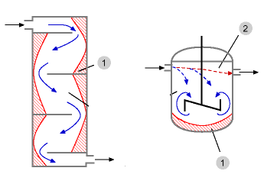
Nonideal Flow in a CSTR
Ideal CSTR: uniform reactant concentration throughout the vessel
Real stirred tank
  Relatively high reactant concentration at the feed entrance
  Relatively low concentration in the stagnant regions, called dead zones (usually corners and behind baffles)
Short Circuiting
Dead Zone
Dead Zone

Slide 7
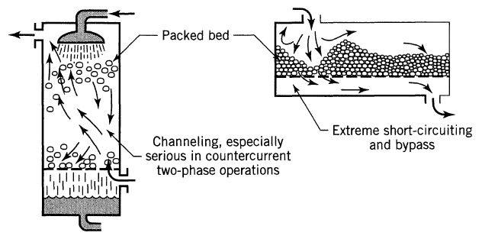
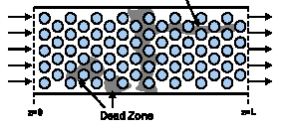
Nonideal Flow in a PBR
Ideal plug flow reactor: all reactant and product molecules at any given axial position move at same rate in the direction of the bulk fluid flow
Real plug flow reactor: fluid velocity profiles, turbulent mixing, & molecular diffusion cause molecules to move with changing speeds and in different directions
channeling
Dead zones

Slide 8
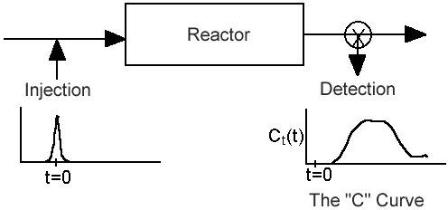
Residence Time Distribution (RTD)
Flow through a reactor is characterized by:
The amount of time molecules spend in the reactor, called the RTD
Quality of mixing
RTD ≡ E(t) ≡ “residence time distribution” function
RTD is measured experimentally by injecting an inert “tracer” at t=0 and measuring the tracer concentration C(t) at the exit as a function of time
Tracer should be easy to detect & have physical properties similar to the reactant
Measurement of RTD
(PBR or PFR)
This plot would have the same shape as the pulse injection if the reactor had perfect plug flow
Pulse injection
Detection

Slide 9
RTD Profiles & Cum RTD Function F(t)
Tracer Conc
Tracer Conc
Tracer Conc
Tracer Conc
τ
t
t
τ
t
t
Nearly ideal PFR
Nearly ideal CSTR
PBR w/ channeling & dead zones
CSTR with dead zones

Slide 10
Calculation of RTD
The C curve
RTD ≡ E(t) ≡ “residence time distribution” function
RTD describes the amount of time molecules have spent in the reactor
C(t)
t
Fraction of material leaving the reactor that has resided in the reactor for a time between t₁ & t₂
E(t)=0 for t<0 since no fluid can exit before it enters
E(t)≥0 for t>0 since mass fractions are always positive
Fraction of fluid element in the exit stream with age less than t₁ is:

Slide 11
A pulse of tracer was injected into a reactor, and the effluent concentration as a function of time is in the graph below. Construct a figure of C(t) & E(t) and calculate the fraction of material that spent between 3 & 6 min in the reactor
t min | 0 | 1 | 2 | 3 | 4 | 5 | 6 | 7 | 8 | 9 | 10 | 12 | 14
C g/m³ | 0 | 1 | 5 | 8 | 10 | 8 | 6 | 4 | 3 | 2.2 | 1.5 | 0.6 | 0
Tabulate E(t): divide C(t) by the total area under the C(t) curve, which must be numerically evaluated
Plot C vs time:

Slide 12
A pulse of tracer was injected into a reactor, and the effluent concentration as a function of time is in the graph below. Construct a figure of C(t) & E(t) and calculate the fraction of material that spent between 3 & 6 min in the reactor
t min | 0 | 1 | 2 | 3 | 4 | 5 | 6 | 7 | 8 | 9 | 10 | 12 | 14
C g/m³ | 0 | 1 | 5 | 8 | 10 | 8 | 6 | 4 | 3 | 2.2 | 1.5 | 0.6 | 0
Tabulate E(t): divide C(t) by the total area under the C(t) curve, which must be numerically evaluated
Plot C vs time:

Slide 13
A pulse of tracer was injected into a reactor, and the effluent concentration as a function of time is in the graph below. Construct a figure of C(t) & E(t) and calculate the fraction of material that spent between 3 & 6 min in the reactor
t min | 0 | 1 | 2 | 3 | 4 | 5 | 6 | 7 | 8 | 9 | 10 | 12 | 14
C g/m³ | 0 | 1 | 5 | 8 | 10 | 8 | 6 | 4 | 3 | 2.2 | 1.5 | 0.6 | 0
E(t) | 0 | 0.02 | 0.1 | 0.16 | 0.2 | 0.16 | 0.12 | 0.08 | 0.06 | 0.044 | 0.03 | 0.012 | 0
t min | 0 | 1 | 2 | 3 | 4 | 5 | 6 | 7 | 8 | 9 | 10 | 12 | 14
C g/m³ | 0 | 1 | 5 | 8 | 10 | 8 | 6 | 4 | 3 | 2.2 | 1.5 | 0.6 | 0
Plot E vs time:
Tabulate E(t): divide C(t) by the total area under the C(t) curve:

Slide 14
A pulse of tracer was injected into a reactor, and the effluent concentration as a function of time is in the graph below. Construct a figure of C(t) & E(t) and calculate the fraction of material that spent between 3 & 6 min in the reactor
t min | 0 | 1 | 2 | 3 | 4 | 5 | 6 | 7 | 8 | 9 | 10 | 12 | 14
C g/m³ | 0 | 1 | 5 | 8 | 10 | 8 | 6 | 4 | 3 | 2.2 | 1.5 | 0.6 | 0
E(t) | 0 | 0.02 | 0.1 | 0.16 | 0.2 | 0.16 | 0.12 | 0.08 | 0.06 | 0.044 | 0.03 | 0.012 | 0
t min | 0 | 1 | 2 | 3 | 4 | 5 | 6 | 7 | 8 | 9 | 10 | 12 | 14
C g/m³ | 0 | 1 | 5 | 8 | 10 | 8 | 6 | 4 | 3 | 2.2 | 1.5 | 0.6 | 0
E vs time:
Fraction of material that spent between 3 & 6 min in reactor = area under E(t) curve between 3 & 6 min
Evaluate numerically:

Slide 15
Step-Input to Determine E(t)
Disadvantages of pulse input:
Injection must be done in a very short time
Can be inaccurate when the c-curve has a long tail
Amount of tracer used must be known
Alternatively, E(t) can be determined using a step input:
Conc. of tracer is kept constant until outlet conc. = inlet conc.
injection
detection
C_{in}
C_{out}
C₀
C₀
The C curve
t
t
t
t

Slide 16
Questions
1. Which of the following graphs would you expect to see if a pulse tracer test were performed on an ideal CSTR?
A
B
C
D
Tracer Conc
Tracer Conc
Tracer Conc
Tracer Conc
t
t
τ
t
t
2. Which of the following graphs would you expect to see if a pulse tracer test were performed on a PBR that had dead zones?
A
B
C
D
Tracer Conc
Tracer Conc
Tracer Conc
Tracer Conc
t
t
τ
t
t

Slide 17
Cumulative RTD Function F(t)
F(t) = fraction of effluent that has been in the reactor for less than time t
F(t)
0.8
80% of the molecules spend 40 min or less in the reactor
t
40

Slide 18
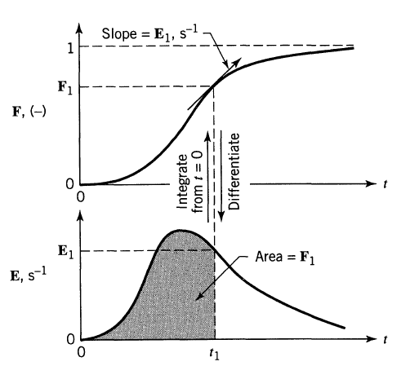
Relationship between E & F Curves
F(t) = fraction of effluent that has been in the reactor for less than time t
E(t)= Fraction of material leaving reactor that was inside for a time between t₁ & t₂

Slide 19
Boundary Conditions for the
Cum RTD Function F(t)
C(t)
C(t)
C(t)
C(t)
τ
t
t
τ
t
t
Nearly ideal PFR
Nearly ideal CSTR
PBR with channeling & dead zones
CSTR with dead zones
F(t)=fraction of effluent in the reactor less for than time t
F(t)
0.8
80% of the molecules spend 40 min or less in the reactor
t (min)
40

Slide 20
Mean Residence Time, t_{m}
For an ideal reactor, the space time τ is defined as V/υ₀
The mean residence time t_{m} is equal to τ in either ideal or nonideal reactors
By calculating t_{m}, the reactor V can be determined from a tracer experiment
The spread of the distribution (variance):
Space time τ and mean residence time t_{m} would be equal if the following two conditions are satisfied:
  No density change
  No backmixing
In practical reactors the above two may not be valid, hence there will be a difference between them

Slide 21
RTD in Ideal Reactors
All the molecules leaving a PFR have spent ~ the same amount of time in the PFR, so the residence time distribution function is:
The Dirac delta function satisfies:
…but =1 over the entire interval
Zero everywhere but one point

